Slide 1

Customer Segmentation
Using K-means clustering algorithm

Slide 2
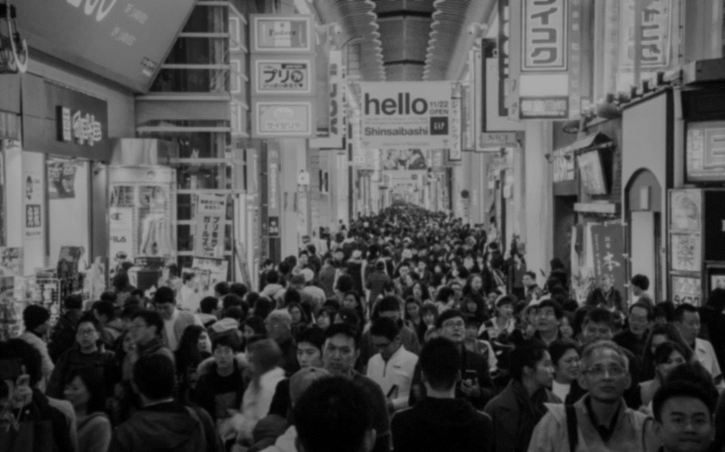
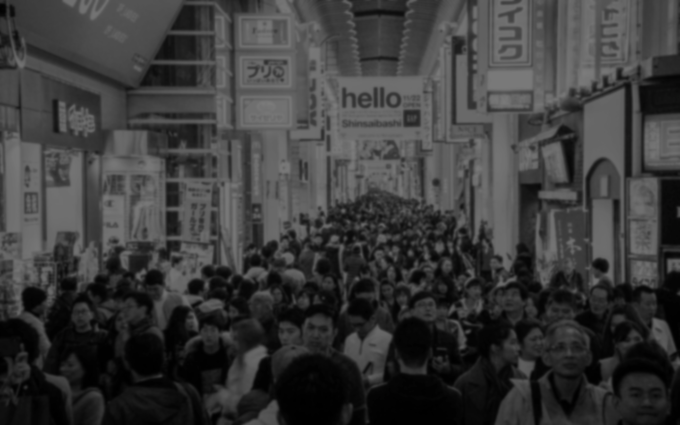
Abstract
Customer Segmentation is the subdivision of a market into discrete customer groups that share similar characteristics. Customer Segmentation can be a powerful means to identify unsatisfied customer needs. Using the above data companies can then outperform the competition by developing uniquely appealing products and services.
You are owing a supermarket mall and through membership cards, you have some basic data about your customers like Customer ID, age, gender, annual income and spending score. You want to understand the customers like who are the target customers so that the sense can be given to marketing team and plan the strategy accordingly.

Slide 3
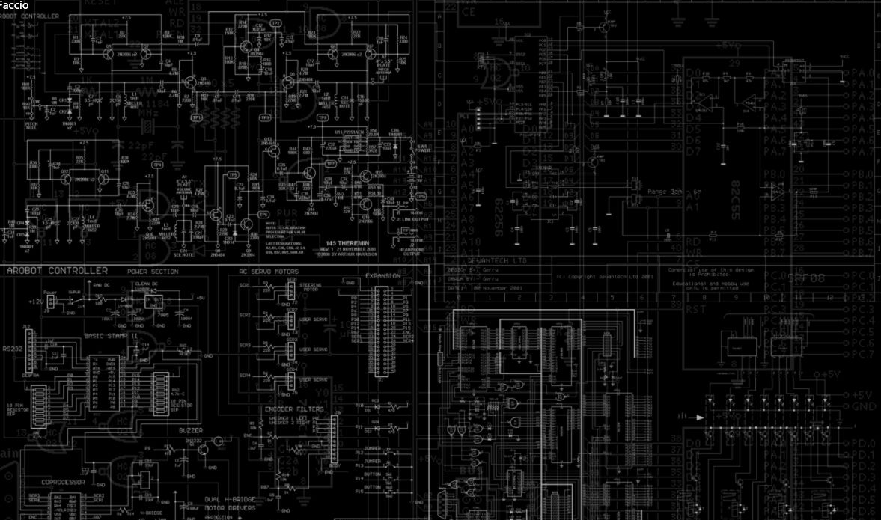
Table of Contents
Table of Contents
Methodology
Existing
Method
Introduction
Conclusion
Architecture

Slide 4

Introduction
Clustering helps marketers improve their customer base, work on target areas, and segment customers based on purchase history, interests, or activity monitoring.
The scope of relationship marketing is to retain customers and win their loyalty. This can be achieved if the companies’ products and services are developed and sold considering customers ’demands. Fulfilling customers’ demands, taken as the starting point of relationship marketing, can be obtained by acknowledging that the customers’ needs and wishes are heterogeneous.
The segmentation of the customers’ base allows operators to overcome this because it illustrates the whole heterogeneous market as the sum of smaller homogeneous markets. The concept of segmentation relies on the high probability of persons grouped into segments based on common demands and behaviours to have a similar response to marketing strategies.

Slide 5
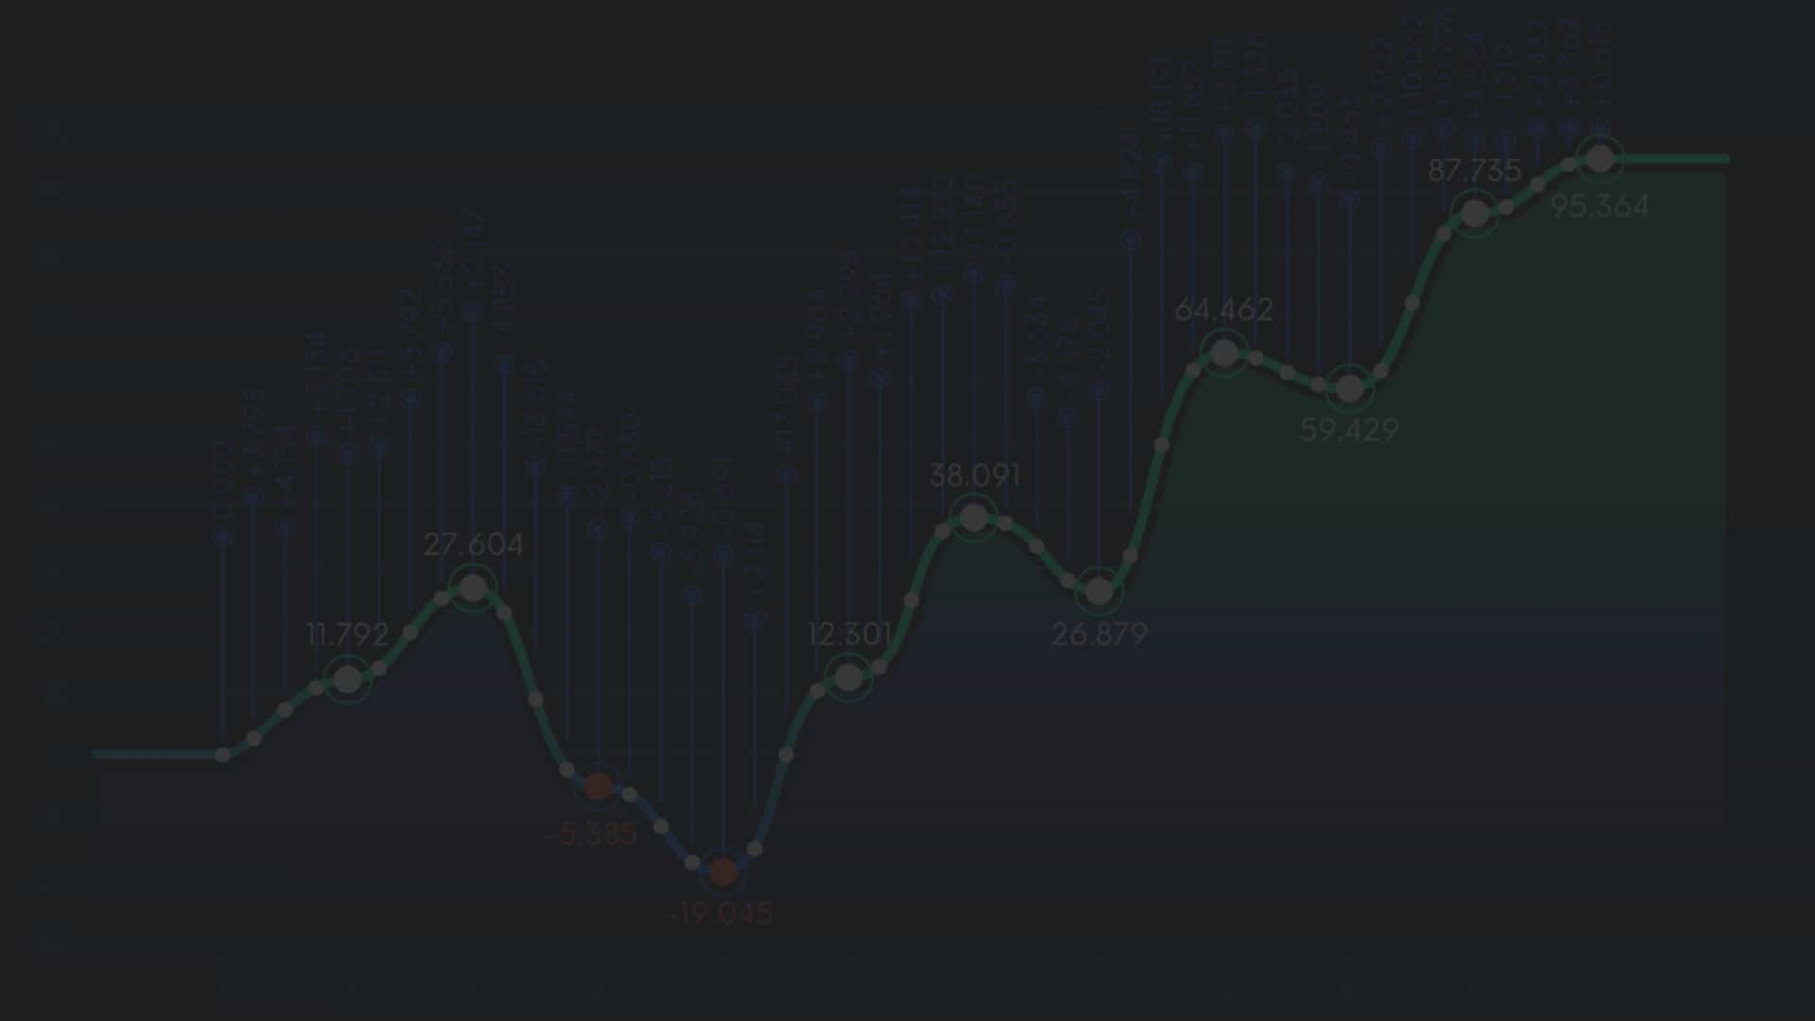
Existing Method
Hierarchical clustering, as the name suggests is an algorithm that builds hierarchy of clusters. This algorithm starts with all the data points assigned to a cluster of their own. Then two nearest clusters are merged into the same cluster. In the end, this algorithm terminates when there is only a single cluster left.
This algorithm has been implemented using bottom up approach. It is also possible to follow top-down approach starting with all data points assigned in the same cluster and recursively performing splits till each data point is assigned a separate cluster.

Slide 6
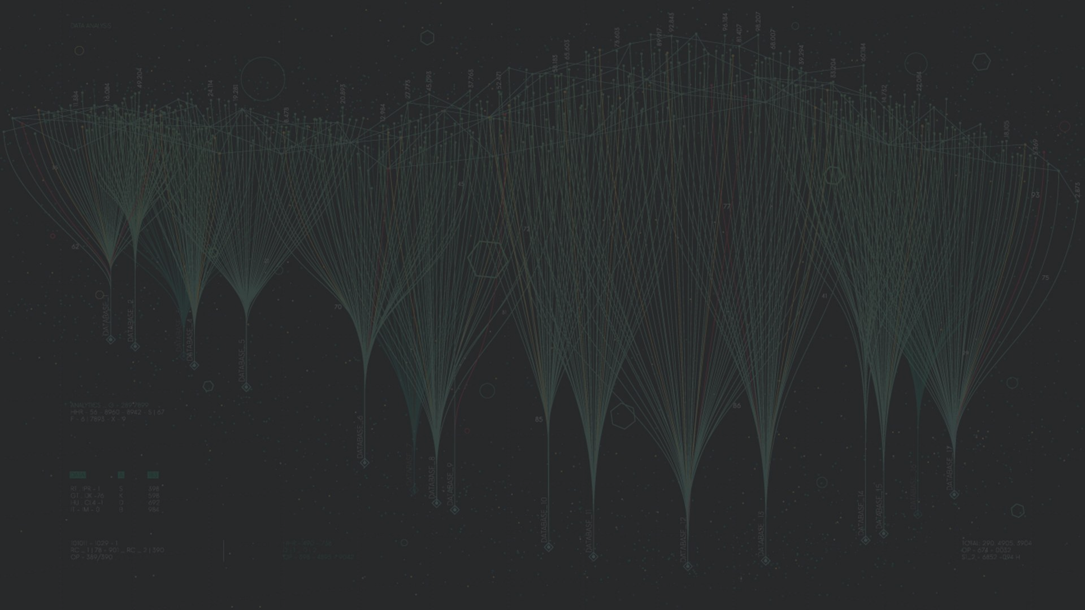
Existing Method
The decision of merging two clusters is taken on the basis of closeness of these clusters. There are multiple metrics for deciding the closeness of two clusters :
Euclidean distance: ||a-b||₂ = √(Σ(a_{i}-b_{i}))
Squared Euclidean distance: ||a-b||₂² = Σ((a_{i}-b_{i})²)
Manhattan distance: ||a-b||₁ = Σ |a_{i}-b_{i}|
Maximum distance:||a-b||_{INFINITY} = max_{i} |a_{i}-b_{i}|
Mahalanobis distance: √((a-b)^{T} S⁻¹ (-b)) {where, s : covariance matrix}

Slide 7

Proposed Method with Architecture
What is clustering?
Clustering is one of the most common exploratory data analysis technique used to get an intuition about the structure of the data. It can be defined as the task of identifying subgroups in the data such that data points in the same subgroup are very similar while data points in different clusters are very different.
Unlike supervised learning, clustering is considered an unsupervised learning method since we don’t have the ground truth to compare the output of the clustering algorithm to the true labels to evaluate its performance. We only want to try to investigate the structure of the data by grouping the data points into distinct subgroups.

Slide 8
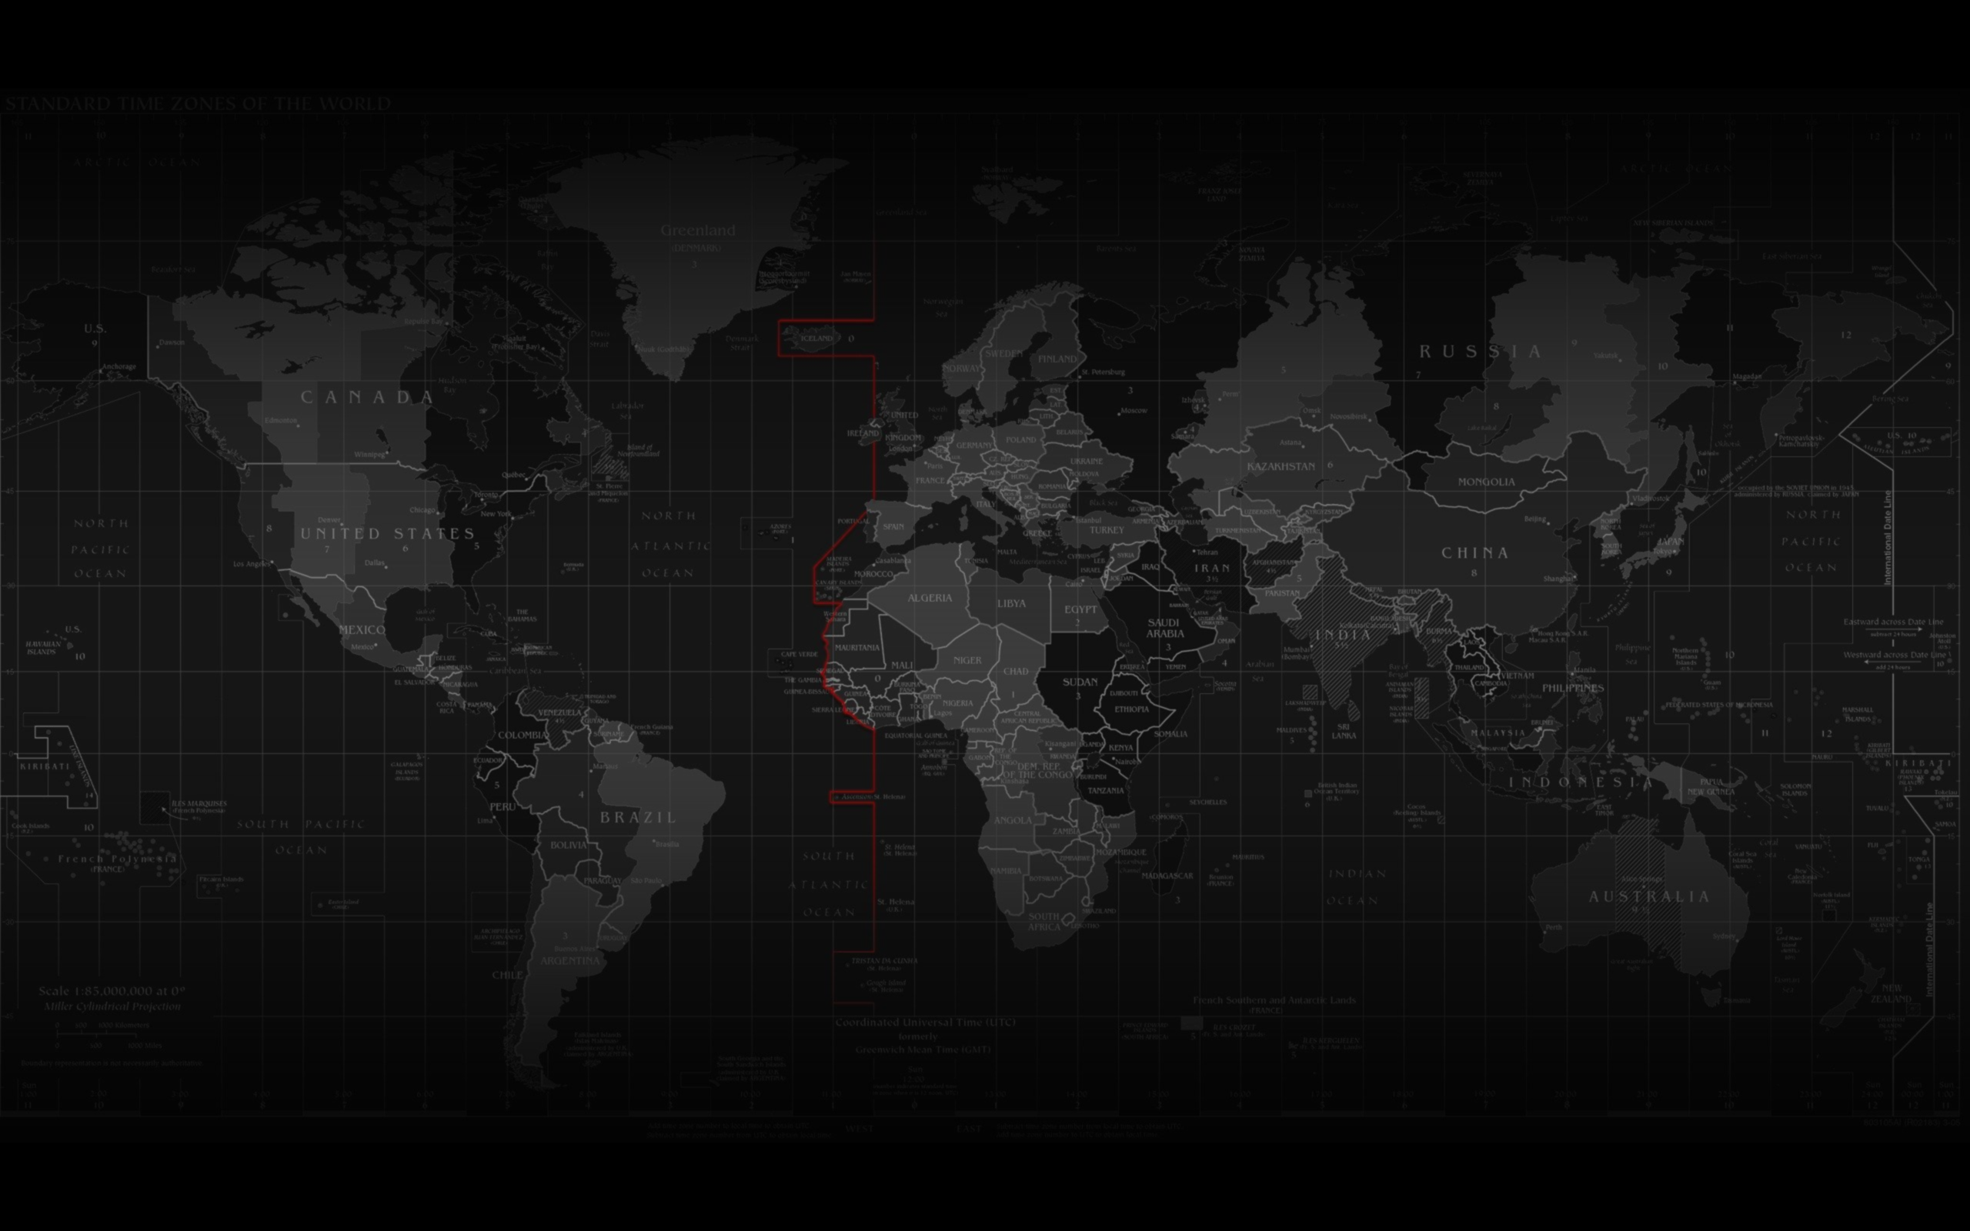
Proposed Method with Architecture
What is K means algorithm?
K means algorithm is an iterative algorithm that tries to partition the dataset into Kpre-defined distinct non-overlapping subgroups where each data point belongs to only one group. It assigns data points to a cluster such that the sum of the squared distance between the data points and the cluster’s centroid is at the minimum. The less variation we have within clusters, the more homogeneous the data points are within the same cluster.

Slide 9

Proposed Method with Architecture
Steps of K means clustering algorithm:
Select the number of clusters for the dataset ( K )
Select K number of centroids
By calculating the Euclidean distance or Manhattan distance assign the points to the nearest centroid, thus creating K groups
Now find the original centroid in each group
Again reassign the whole data point based on this new centroid, then repeat step 4 until the position of the centroid doesn’t change.

Slide 10


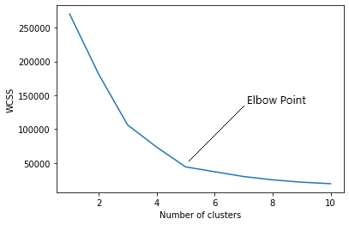
Proposed Method with Architecture
What is Elbow method?
In the Elbow method, we are actually varying the number of clusters ( K ) from 1 – 10. For each value of K, we are calculating WCSS ( Within-Cluster Sum of Square ). WCSS is the sum of squared distance between each point and the centroid in a cluster. When we plot the WCSS with the K value, the plot looks like an Elbow. As the number of clusters increases, the WCSS value will start to decrease. WCSS value is largest when K = 1. When we analyze the graph we can see that the graph will rapidly change at a point and thus creating an elbow shape. From this point, the graph starts to move almost parallel to the X-axis. The K value corresponding to this point is the optimal K value or an optimal number of clusters.

Slide 11

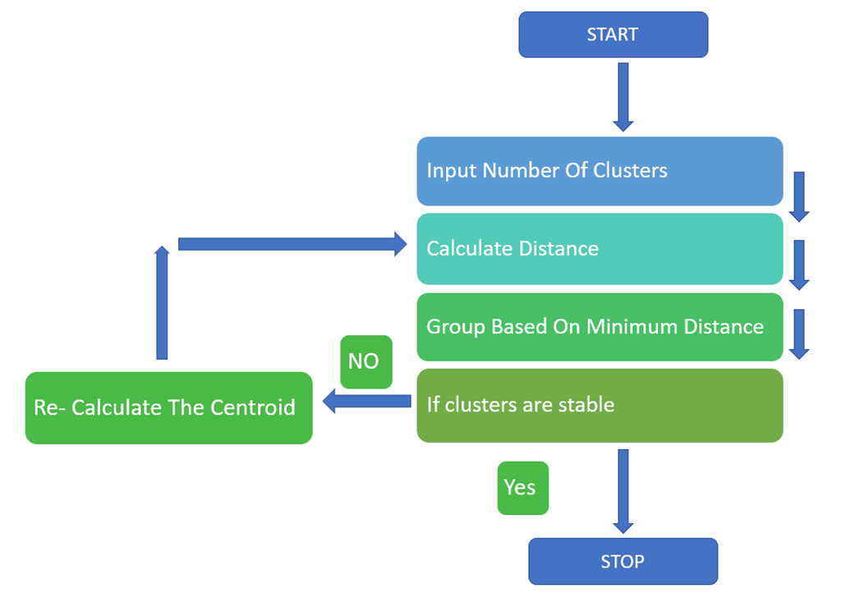
Methodology
Data set contains 200 entries representing data of 200 peoples and a total of 5 attributes. After proper visualization of the data, clustering needs to be done. But, to perform clustering knowing the optimal number of clusters is necessary. Elbow method is used to calculate the optimal number of clusters. Once the number of cluster are calculated, all that is required is to implement the K – Means clustering algorithm and providing it with the cluster number and visualizing it.

Slide 12

Conclusion
K means clustering is one of the most popular clustering algorithms and usually the first thing practitioners apply when solving clustering tasks to get an idea of the structure of the dataset. The goal of K means is to group data points into distinct non-overlapping subgroups. One of the major application of K means clustering is segmentation of customers to get a better understanding of them which in turn could be used to increase the revenue of the company.
Thus, the given datasets of customer segmentations is successfully processed by using K-means clustering algorithm. And it helps to improve customer service.
K means algorithm is one of the most popular clustering algorithms and normally the first thing practitioners apply when solving clustering tasks to get an idea of the structure of the dataset. The goal of K-means is to group data points into distinct non-overlapping subgroups. One of the major application of K means clustering is segmentation of customers to get a better understanding of them which in turn could be used to increase the revenue of the company.

Slide 13
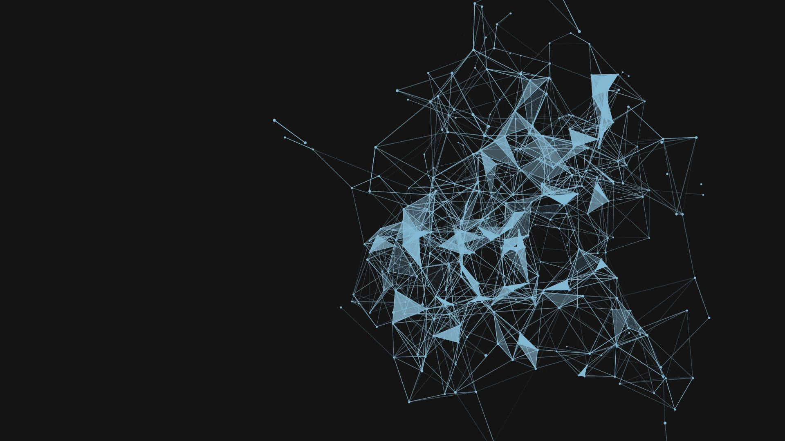
Thank You
Submitted by
Adinath Mahangare
Anushka Chavan

